Slide 1
Autonomous Vocal and Backing Track Mixing
Kelian (Mike) Li
Music Informatics Group

Slide 2
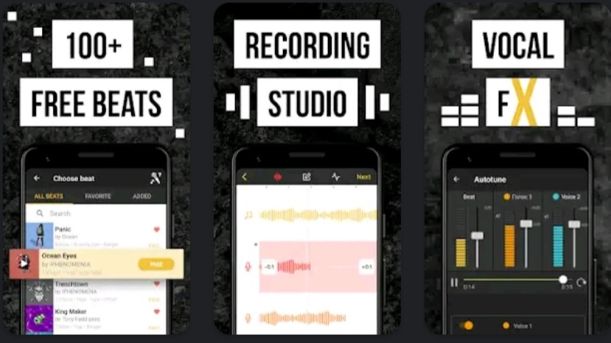
Motivation
Karaoke apps
Amateur music makers

Slide 3
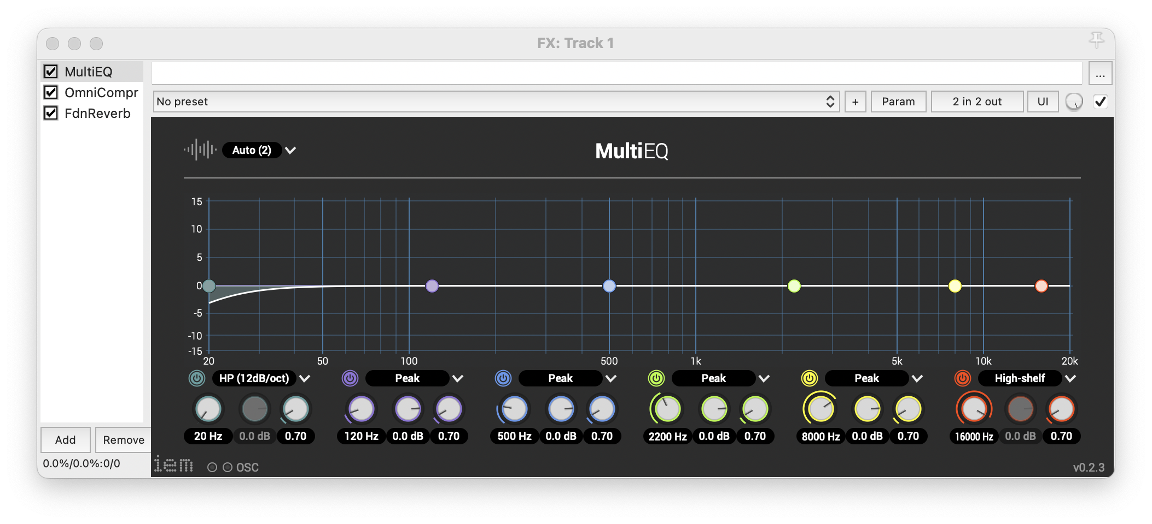
Audio Processing
EQ

Slide 4
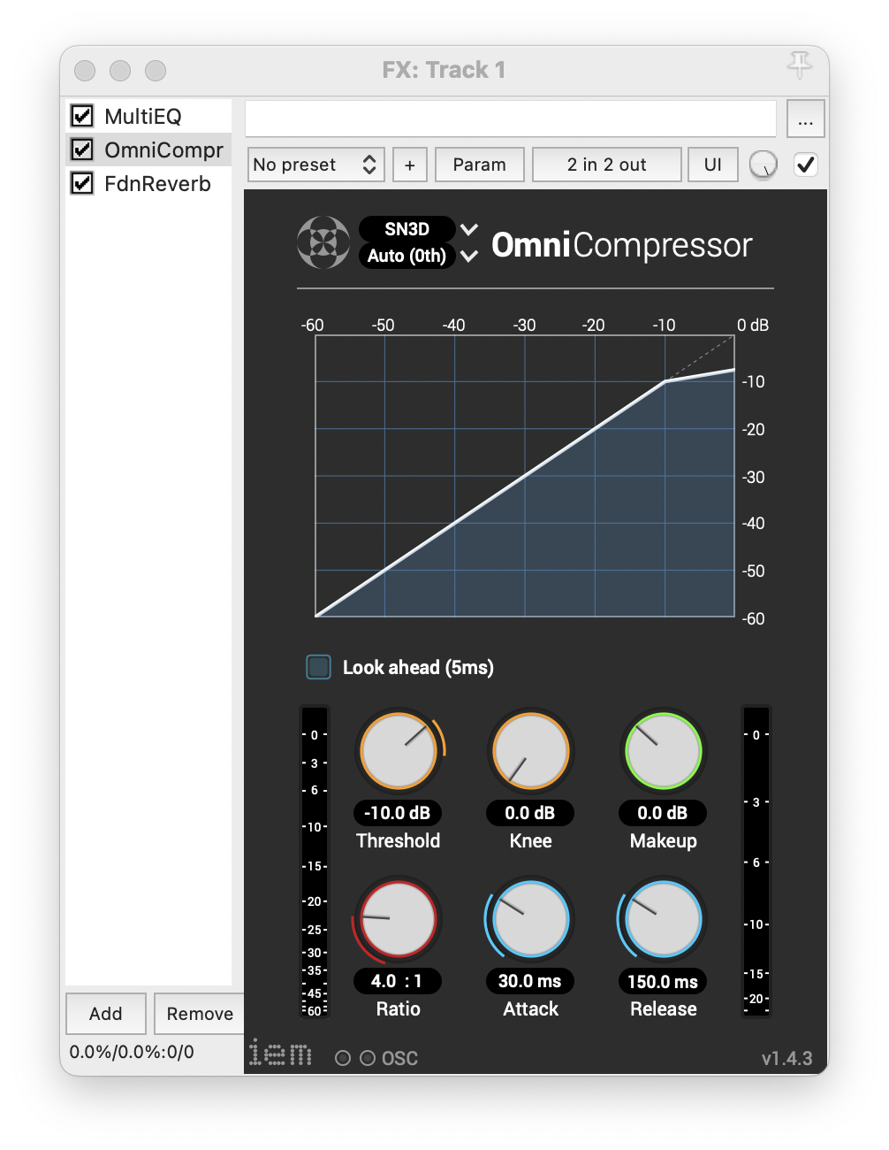
Audio Processing
EQ
Compression

Slide 5
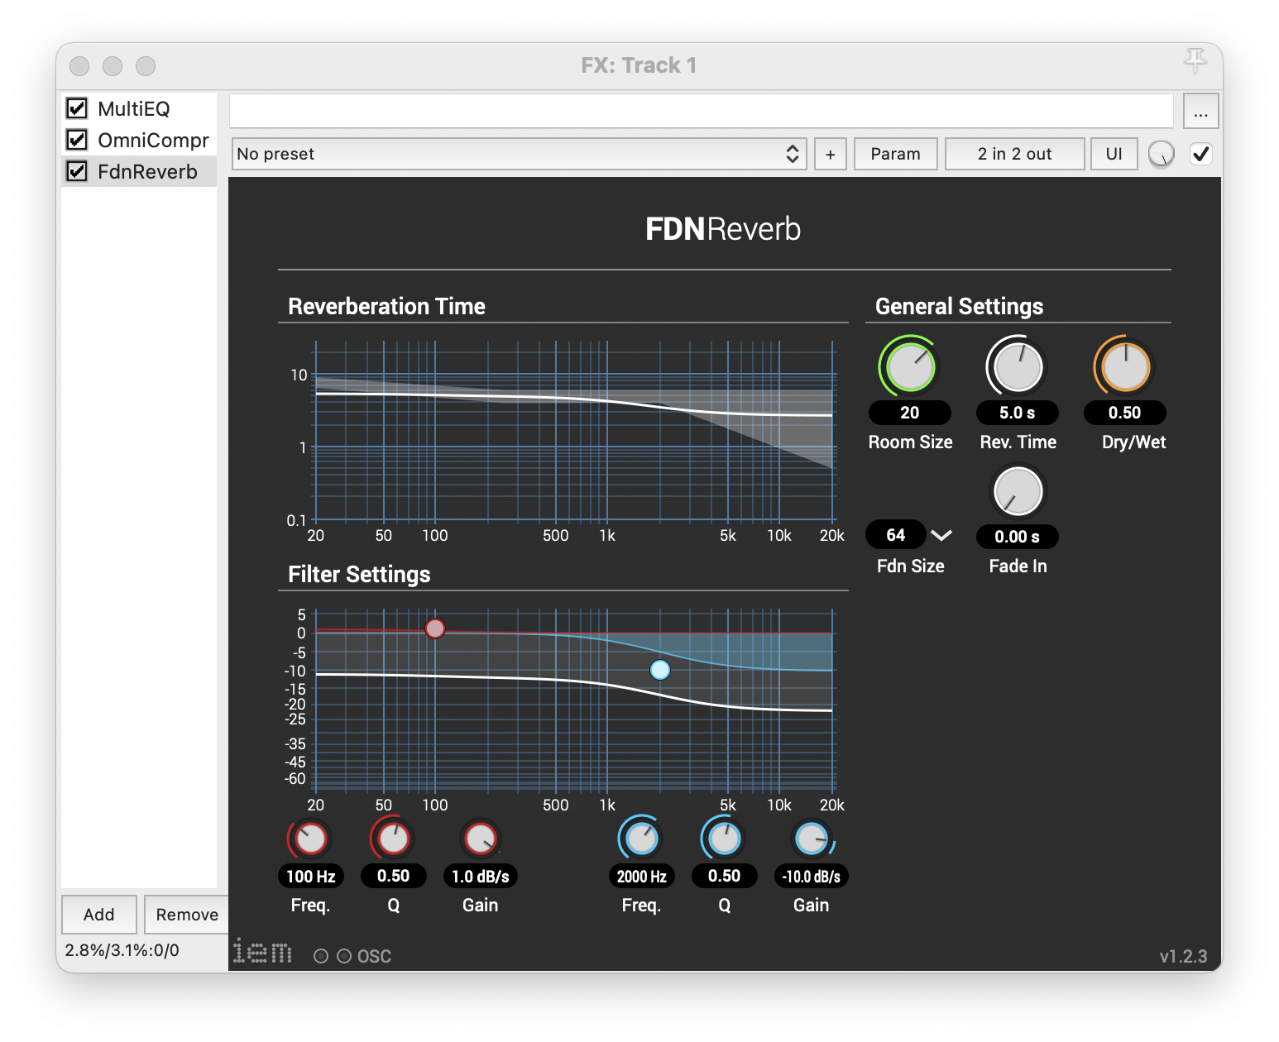
Audio Processing
EQ
Compression
Reverb

Slide 6
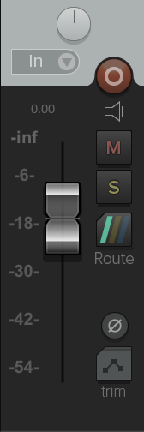
Audio Processing
EQ
Compression
Reverb
Level Balance

Slide 7
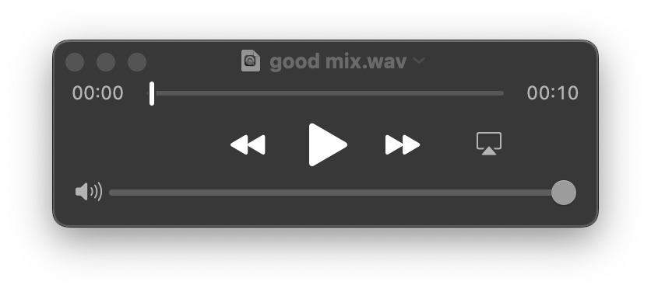
Audio Example
“Very Good” mix

Slide 8

Audio Example
“Very Good” mix
“Very Poor” mix

Slide 9
Data Analysis Approach: level and compression
Use the average values extracted from the source-separated Million Song Dataset
Level balance
-1.77 dB vocal-to-backing track ratio
Compression
16.4 dB loudness range

Slide 10
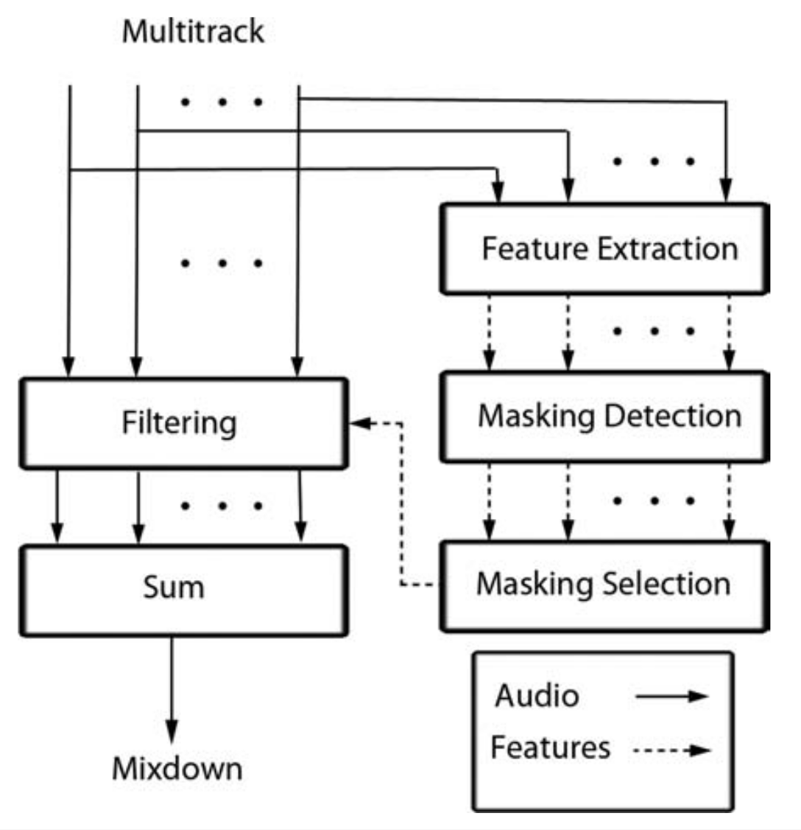
Data Analysis Approach: EQ
EQ
Frequency unmasking

Slide 11
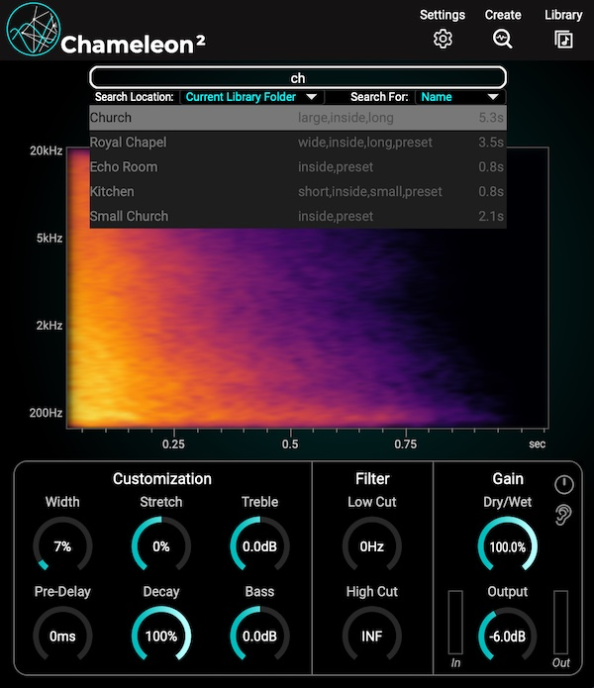
Data Analysis Approach: reverb
Get the estimated impulse responses from the Chameleon plugin
Estimate the reverb parameters by the genetic algorithm
Use mean values extracted from the MUSDB18 train set
Reverb
Dry/wet ratio: 11.5%
Reverb time: Linear mapping from tempo
Room size: 14.54
Fade in time: 0.68 s

Slide 12
Deep Learning Approach
Train a convolutional neural network to predict direct or intermediate mixing parameters based on the input audio
model input:
Mel-spectrogram of the vocal and the backing track
model output:
the same as the previous approach

Slide 13
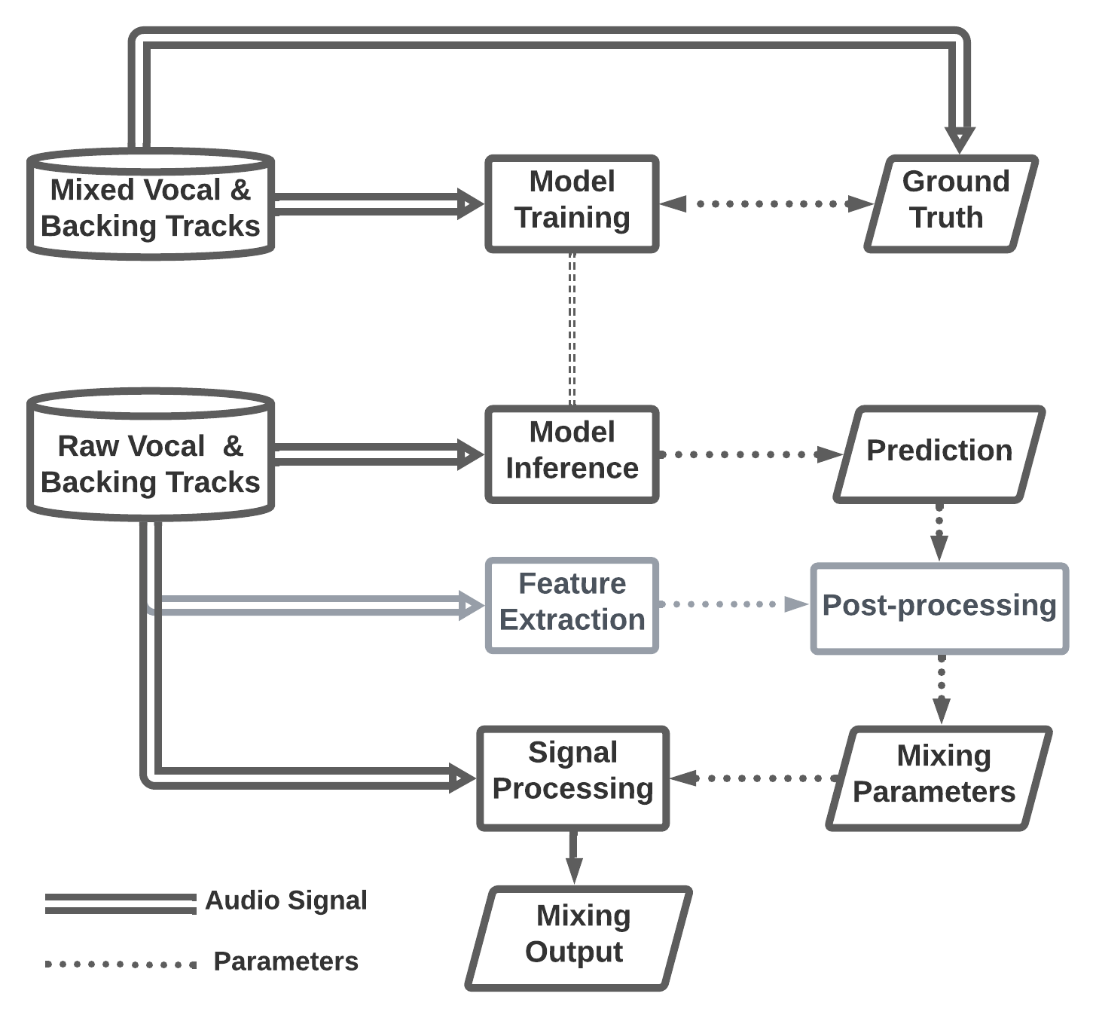

Model Training
Ground truth is the direct or intermediate mixing parameters
Model Inference
Notes:
inference the same for both system
separate training and inference

Slide 14
Model Training
Model Inference
Notes:
inference the same for both system
separate training and inference

Slide 15
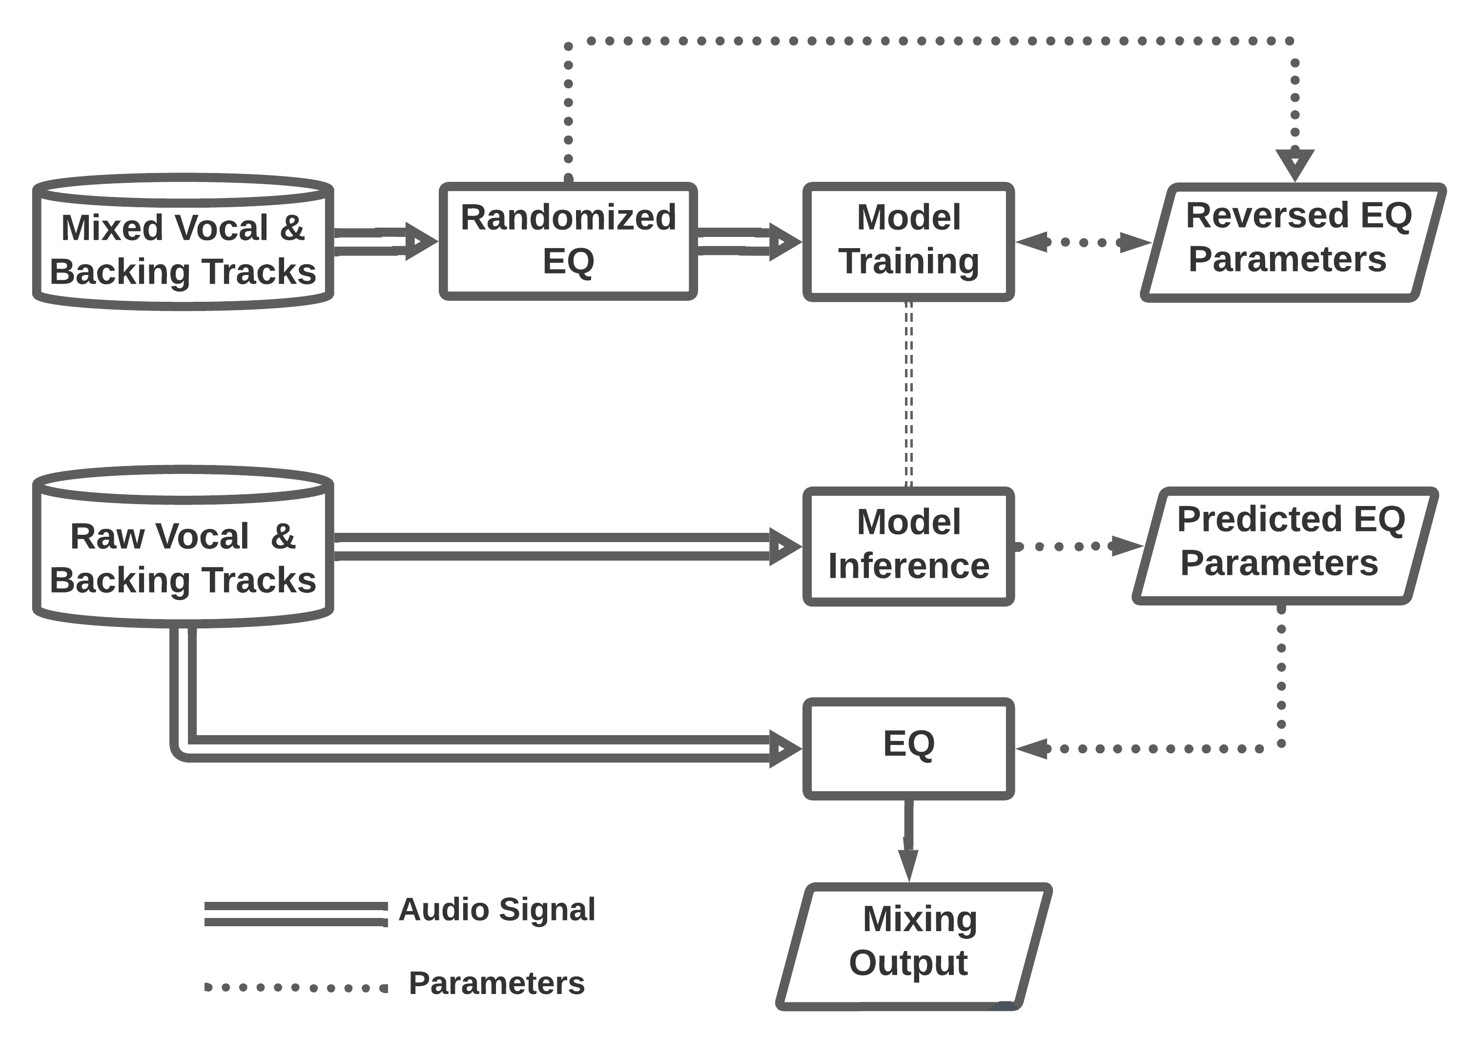
Deep Learning Approach: EQ
Model Training
If the mixed vocal is boosted at a center frequency, we should learn to cut at that frequency.
Model Inference

Slide 16
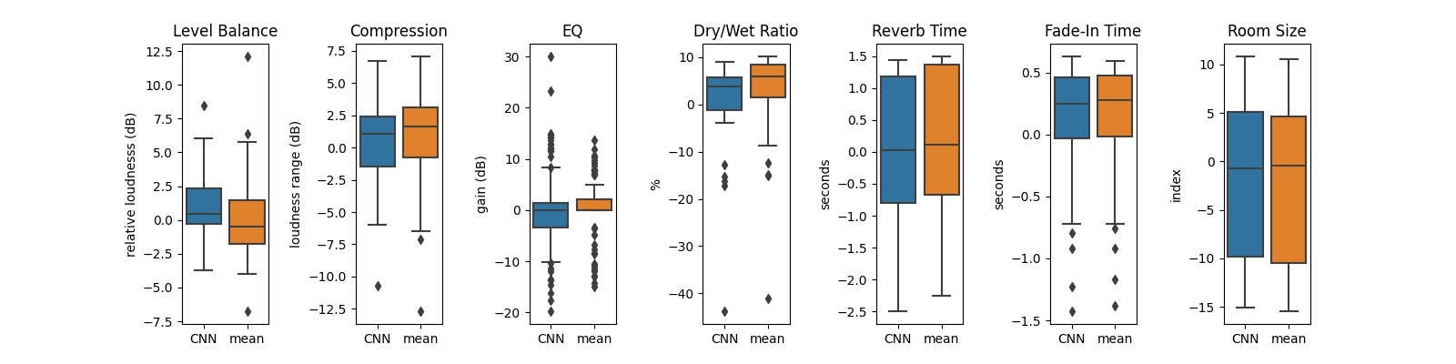
Objective Evaluation
Validation error on the MUSDB test set, 48 songs in total

Slide 17
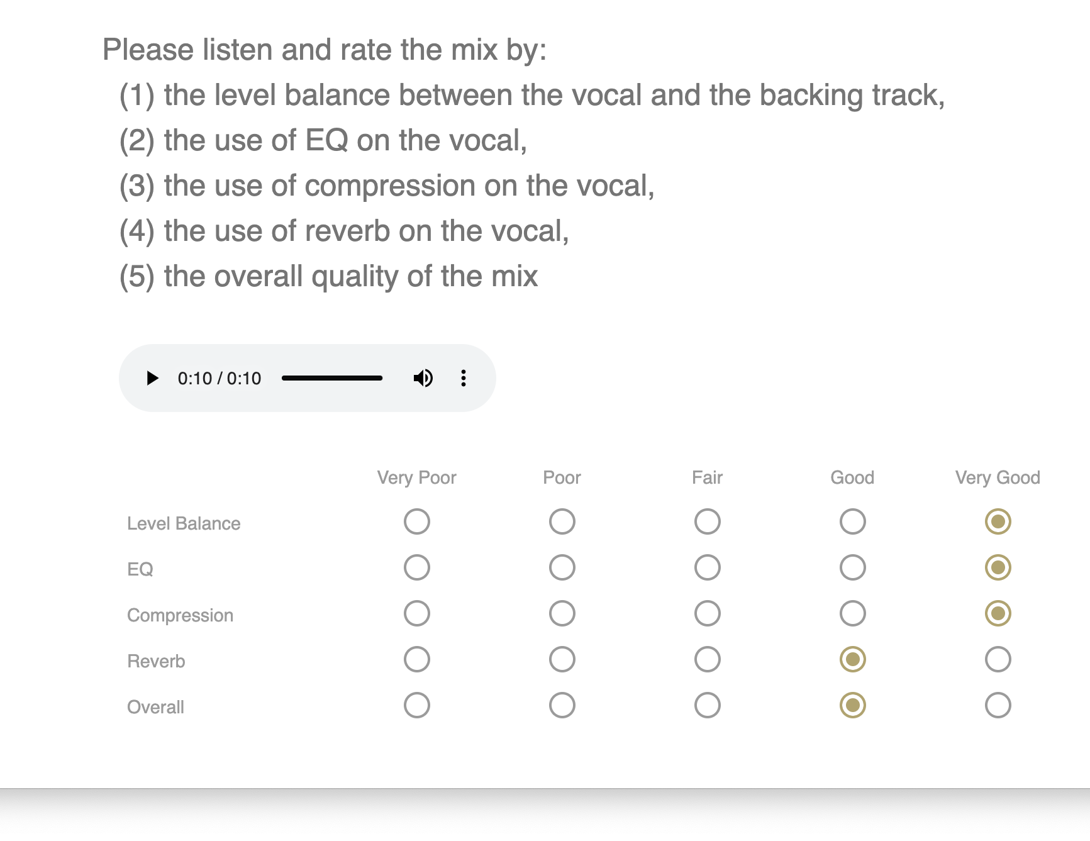
The Final Step: listening test

Slide 18

https://t.ly/0kur

